Slide 1
EasyHome Property Rental System
Presented By
Prathamesh Chavan
Shubham Nigave

Slide 2
Index
Introduction
Purpose
Technology platform used for project
User Roles and Responsibilities
Future scope
Conclusion

Slide 3
Introduction
Purpose:
Our project, the "Property Rental System," aims to simplify the process of renting properties. We’re developing a user-friendly platform where tenants can easily find and apply for rental properties, while landlords and property managers can seamlessly list available units. This web application reduces manual effort, streamlining the rental process for both renters and property owners, making property searching and leasing more efficient for everyone involved.

Slide 4
Technology Used
Front End :- React JS (Version 18) , Bootstrap
Back End :- Java 17, Spring Boot REST API, JPA
Database :- MySQL 8.0. 34

Slide 5

Reason for selecting the specific technology:
React :- It allows us to build large, interactive web applications that can dynamically update data without the need to reload the page. React’s focus on speed, scalability, and simplicity makes it an ideal choice for creating a seamless user experience where tenants can browse properties and landlords can manage listings efficiently.
Java Spring Boot :- It offers a flexible and efficient way to configure Java Beans, handle database transactions, and manage RESTful APIs. Spring Boot's powerful batch processing capabilities and automatic configuration make it a great fit for our application, enabling easy management of user data, property listings, and transactions without requiring manual configuration. This combination ensures a robust, scalable, and smooth-running platform for both tenants and property owners.

Slide 6
User Roles And Responsibilities :-
The Property Rental System consists of three roles :
Admin
Tenant
Landlord

Slide 7



Roles
Tenant
Landlord
Admin
Tenants can view, update, search for available rental properties, Book Properties
Landlords can register, and after verification by the admin, can list new rental properties and view the list of tenants who have applied for their properties. They can accept or reject the Booking.
Admin can manage tenants and landlords. Admin will verify the landlords and their property listings.

Slide 8
Tenant Module
The Tenant Module is designed to streamline the property rental process for tenants. After successful registration and login:-
1.tenants can browse available properties based on location, price range, and amenities. 2.Tenants can book a property, providing details like the desired tenure period.
3.They can track the status of their booking requests, including approvals and rejections from landlords.
4.Once a booking is approved, tenants can proceed to make payments. Payment is processed securely, and the booking status is updated to "Completed" upon successful payment.

Slide 9
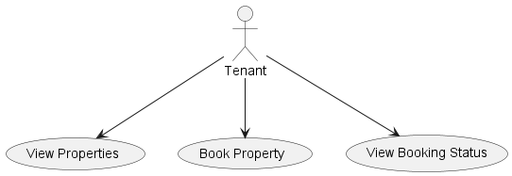
Tenant Use Case Diagram

Slide 10
Landlord Module
The Landlord Module allows property owners to manage their rental listings efficiently. After registration and login:-
1.landlords can add, update, or delete properties, including setting rental prices and uploading images.
2.They can also manage tenant bookings by reviewing incoming requests, approving or rejecting them based on availability and conditions.
3.Once bookings are approved, landlords confirm payments and update booking statuses accordingly.

Slide 11
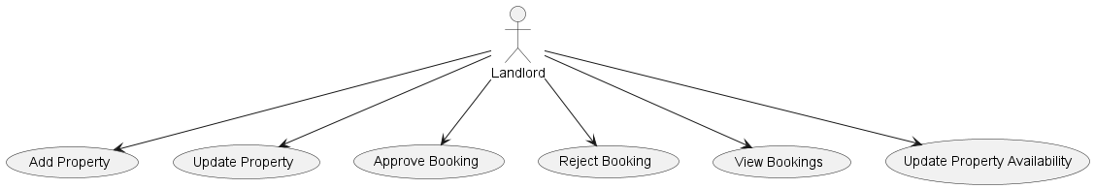
LandLord Use Case Diagram

Slide 12
Admin Module
The Admin Module provides the platform's backend management features.
Admin users can manage the entire system including:-
1.user management (editing and deleting users),
2.property management (adding and deleting properties),
3.booking management (approving, rejecting, or canceling bookings).
4.Admins can also handle payment management and view various reports like booking, revenue, and feedback reports. This module ensures smooth operation and oversight of both tenant and landlord activities, keeping the platform running efficiently. Admins have full control over system data and user interactions.

Slide 13
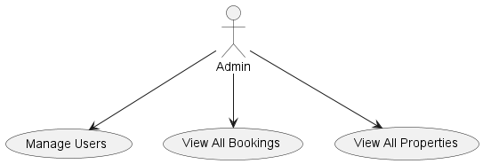
Admin Use Case Diagram

Slide 14
Real-time Future Scope :
Real-time Property Search & Recommendations
Booking Management & Notifications
Payment Integration & Automation
Property Management & Admin Controls
Report Generation & Analytics
Automation of Booking & Payment Reminders
Tenant and Landlord Mobile App Integration
Property Availability & Calendar Synchronization
Security Enhancements (e.g., Two-Factor Authentication)

Slide 15
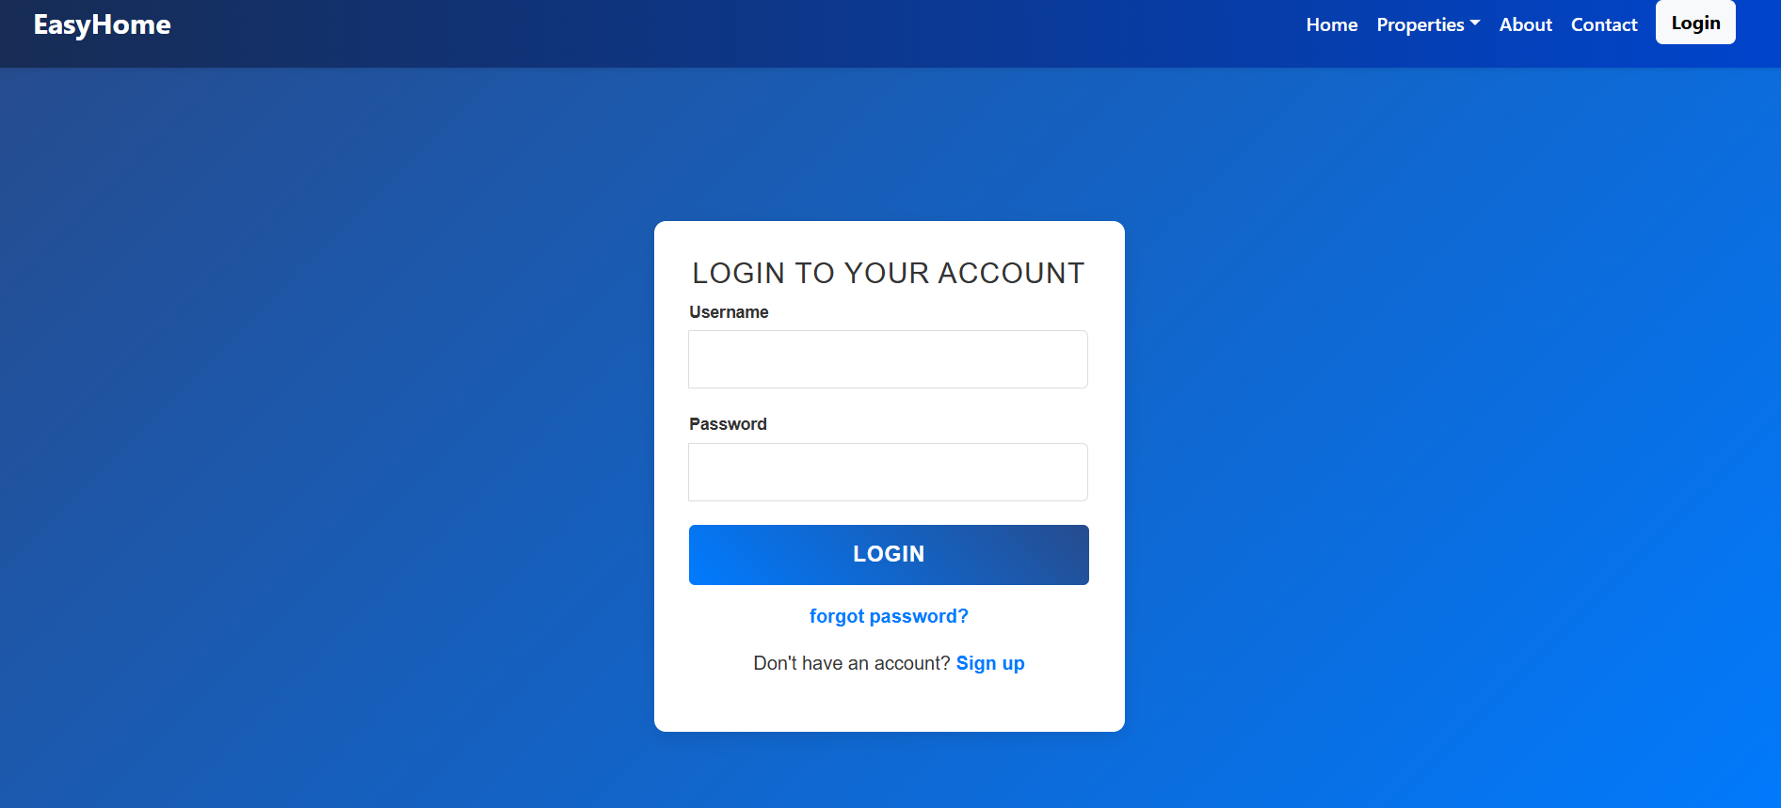
Login Page :

Slide 16
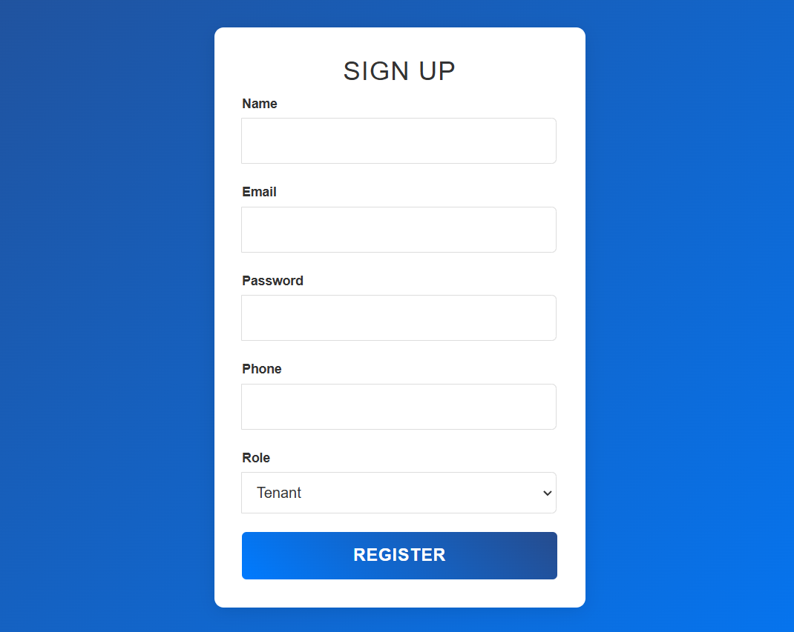
Sign Up :

Slide 17
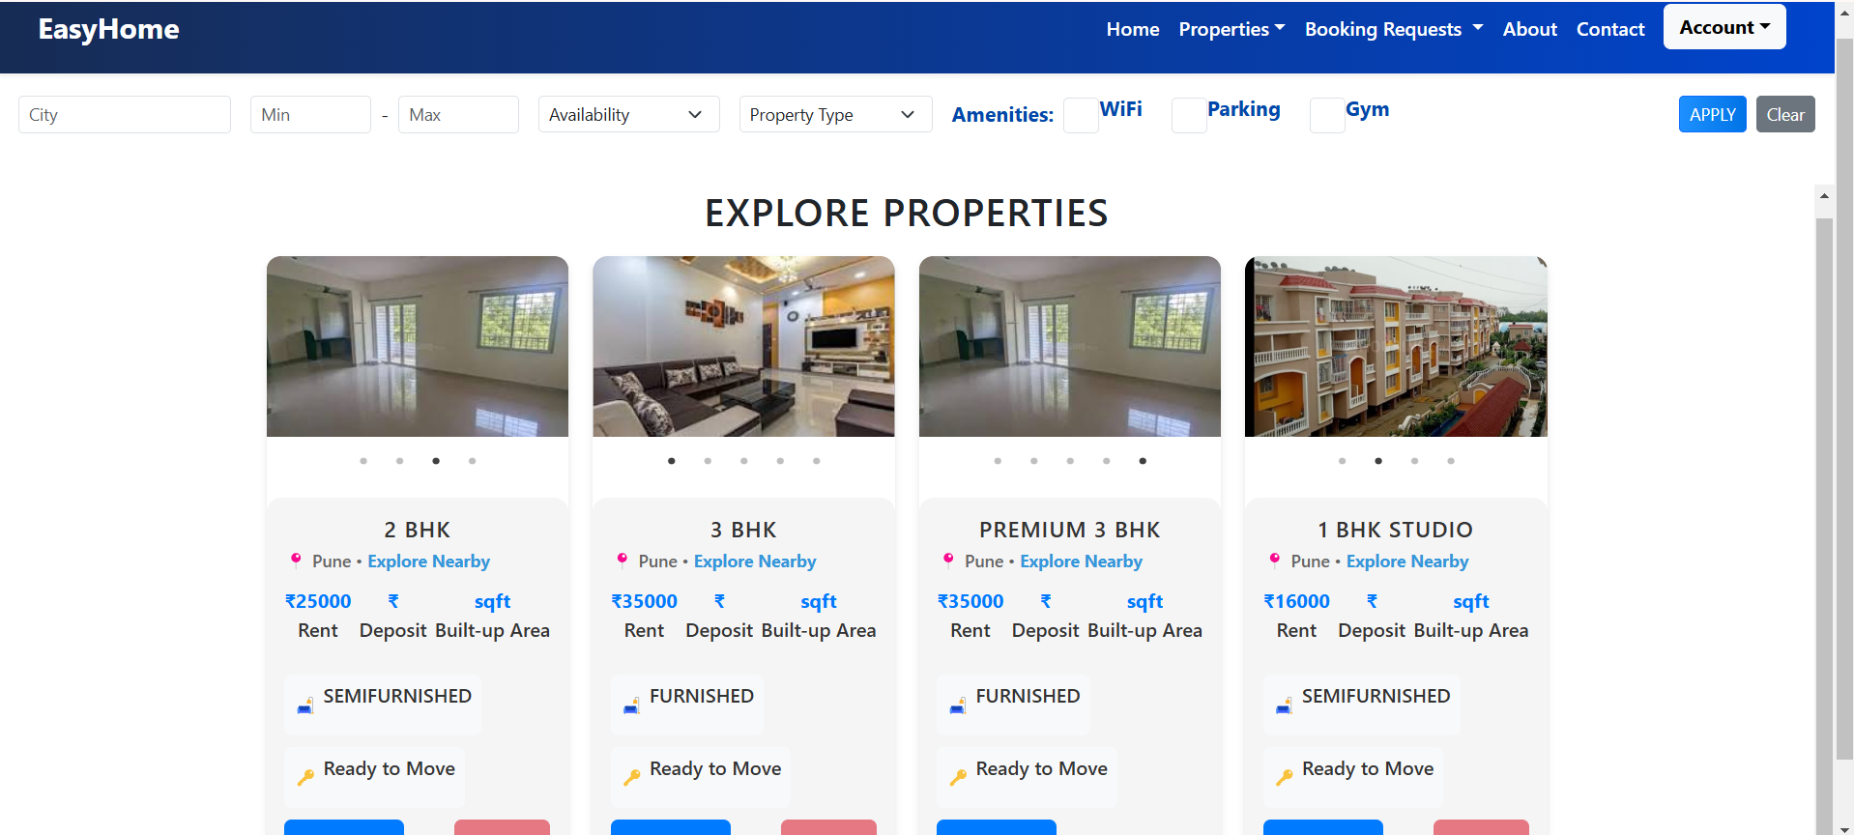
List of Properties :

Slide 18
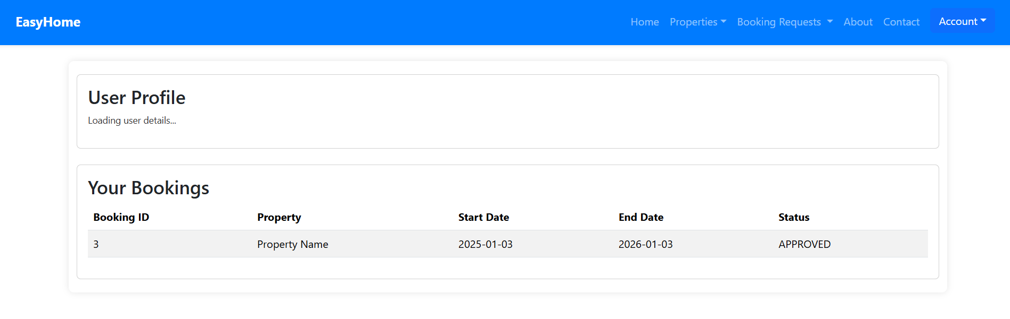
User Profile :

Slide 19
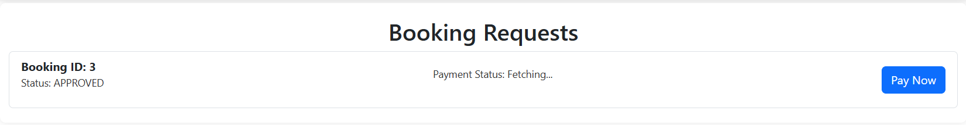

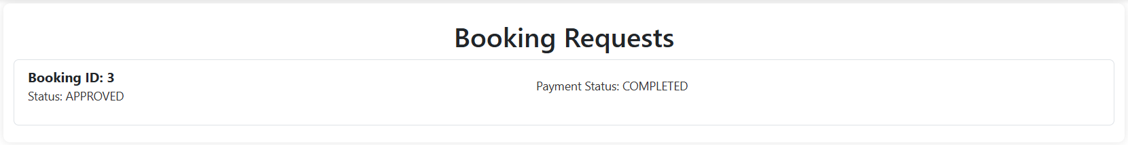
Booking :
1.
2.
3.

Slide 20
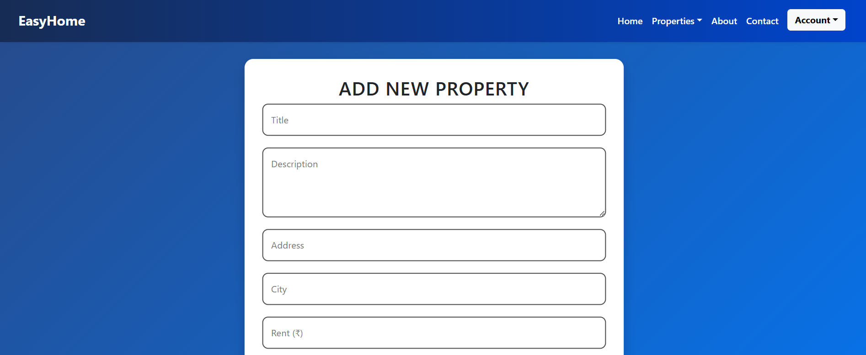
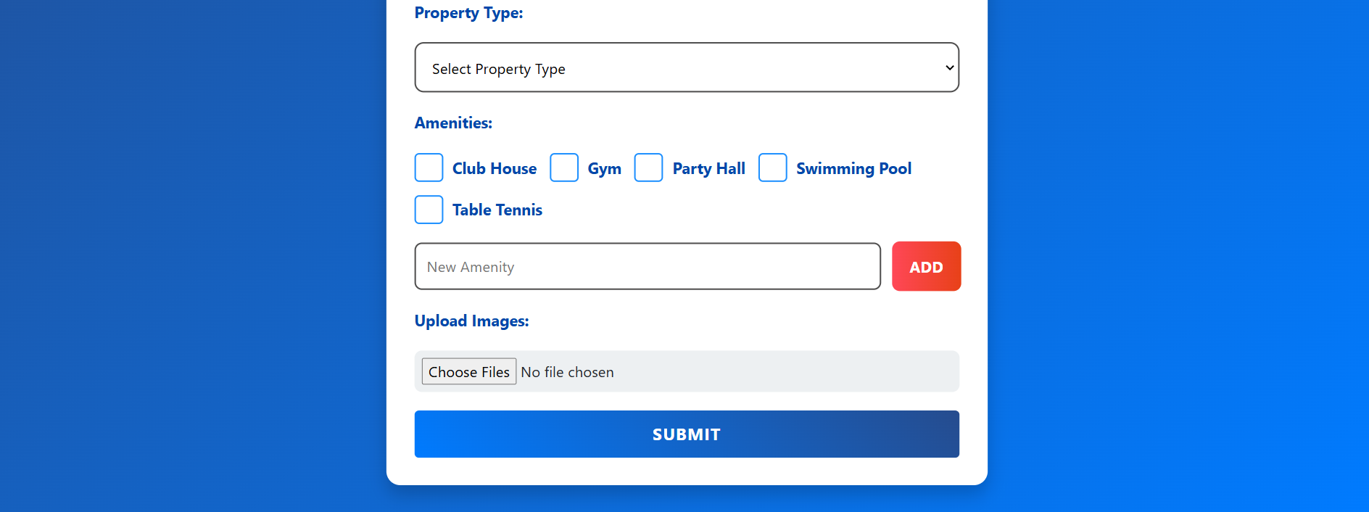
Adding Property :

Slide 21
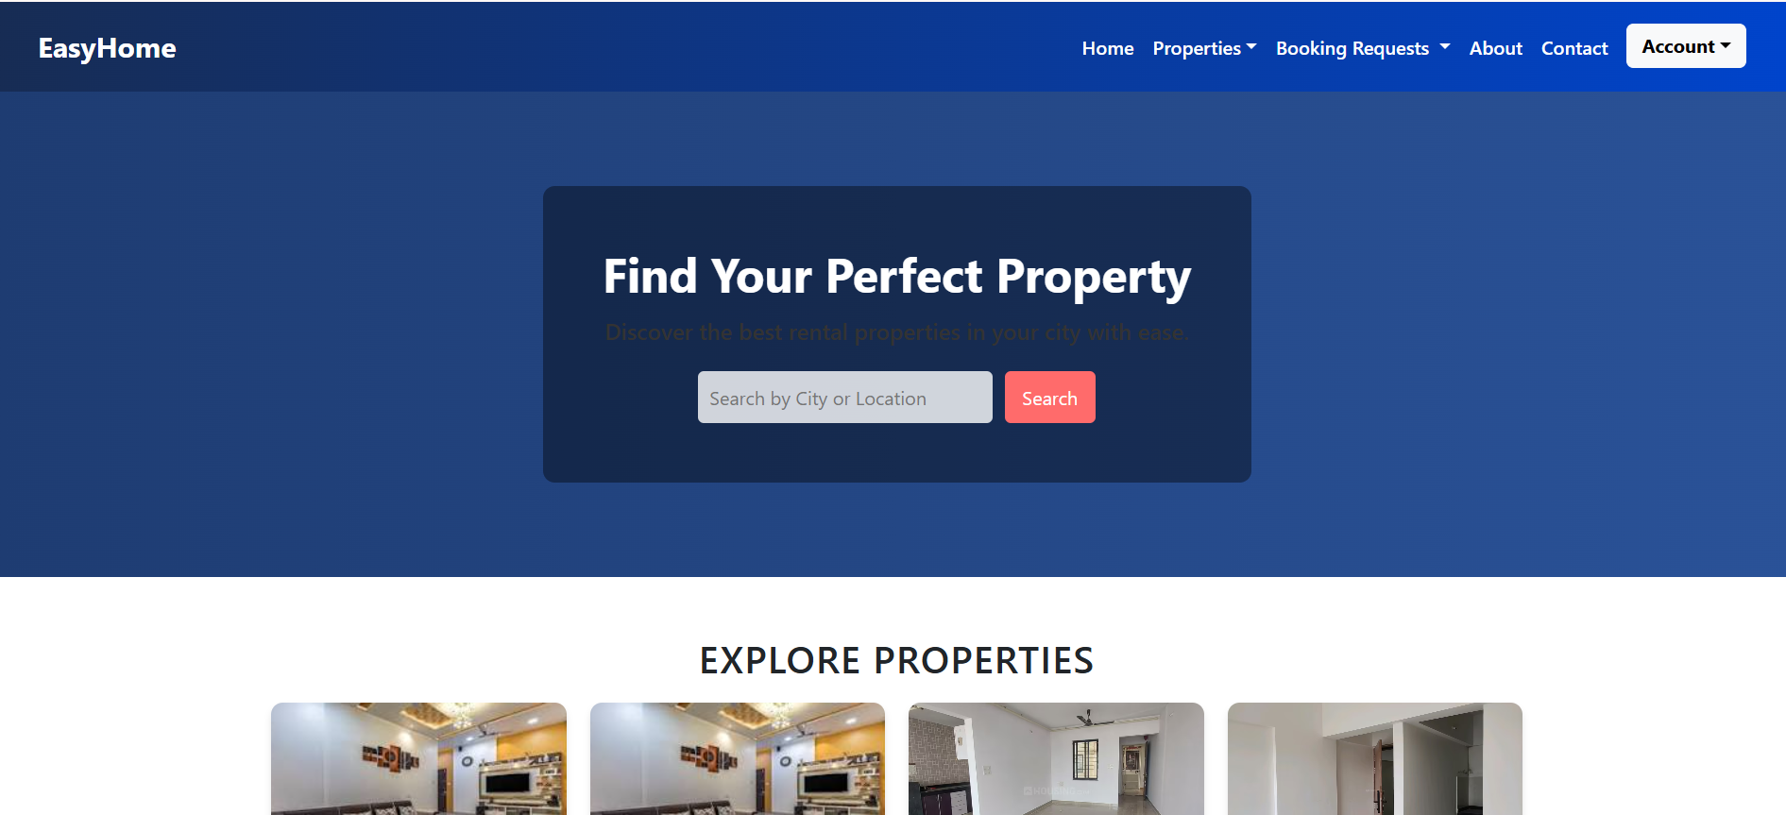
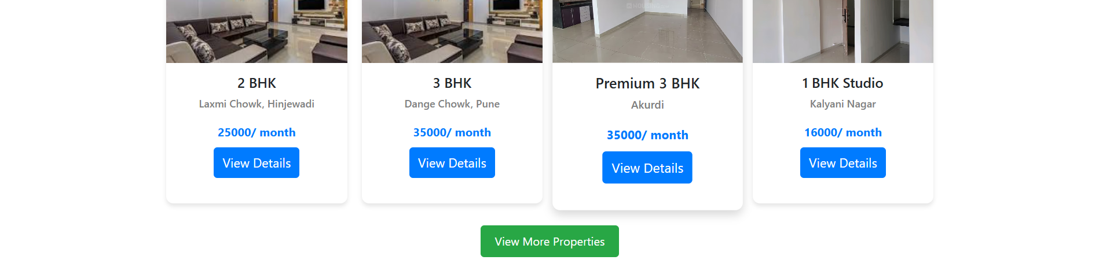
Home Page :-

Slide 22
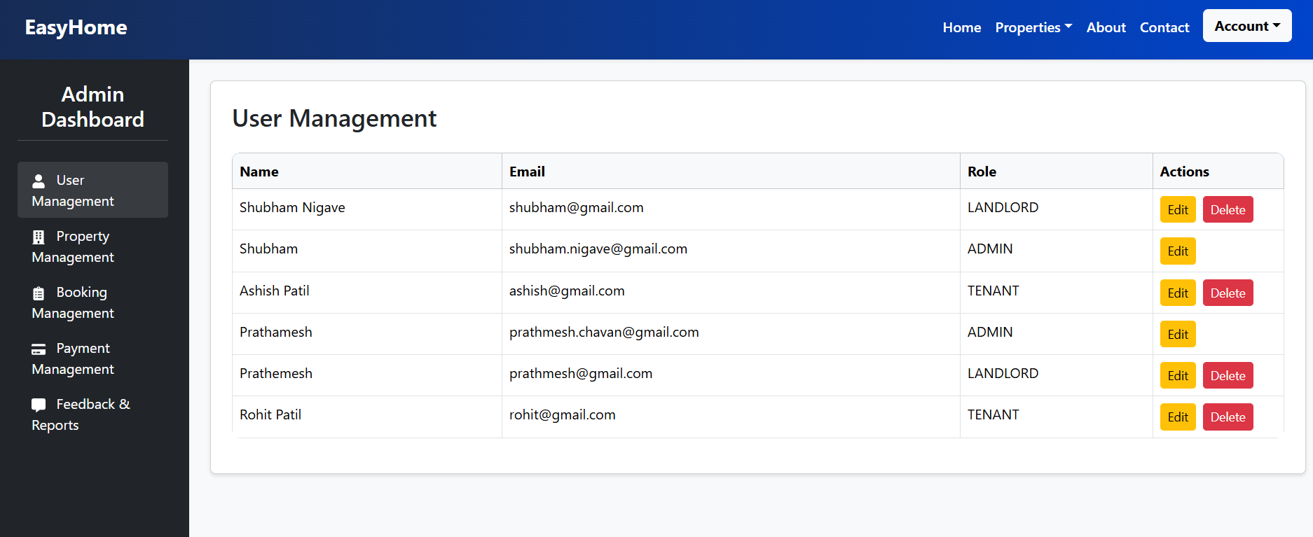
Admin Dashboard :

Slide 23
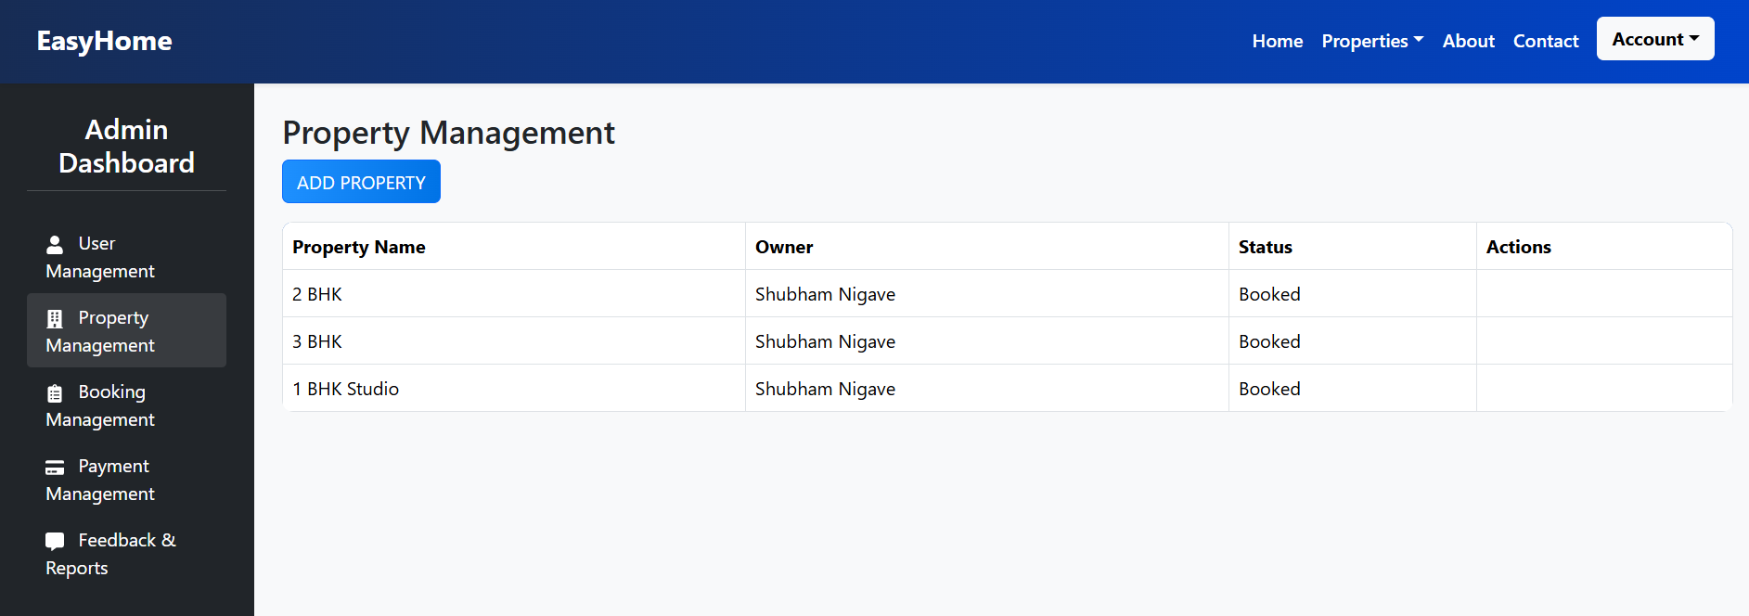
Property Management:

Slide 24
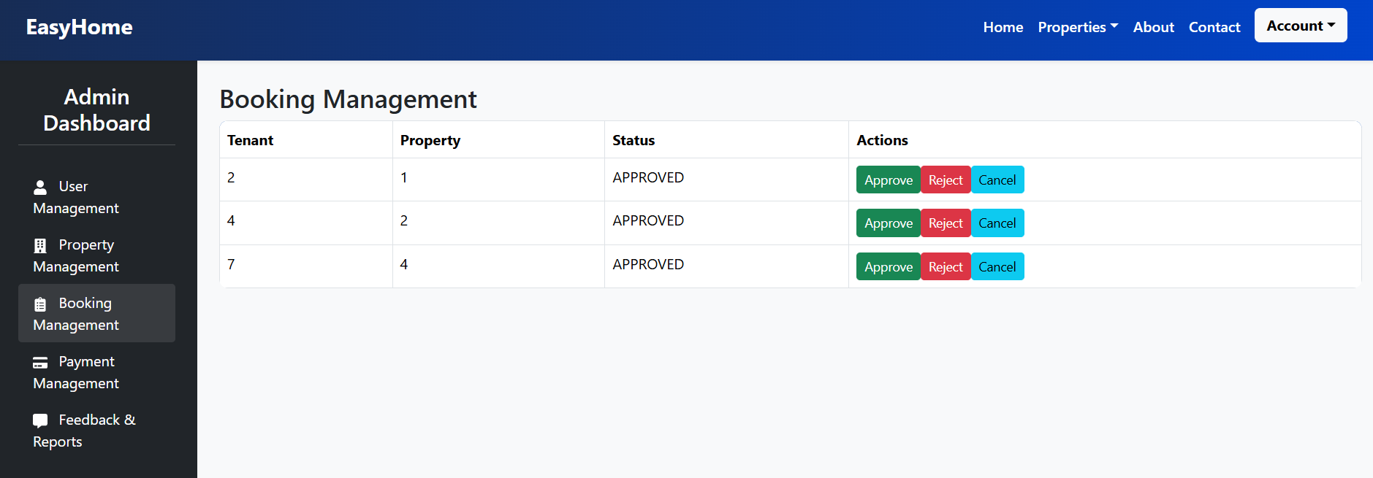
Booking Management

Slide 25
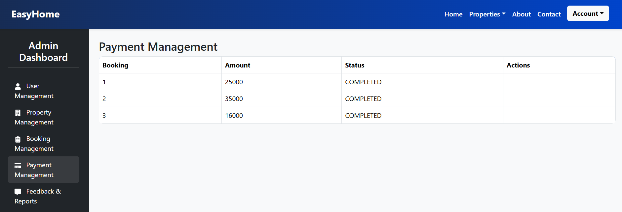
Payment Management :

Slide 26
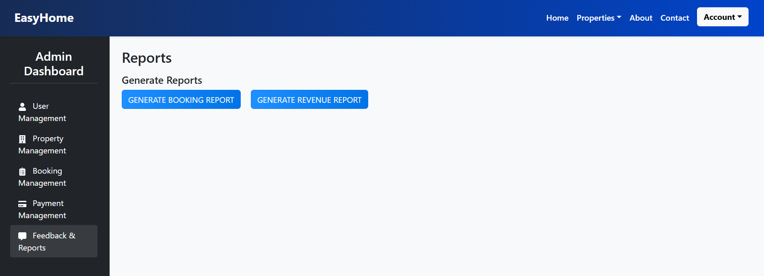
Report Management :

Slide 27
Conclusion :-
EasyHome offers a comprehensive solution to manage the rental process for tenants, landlords, and admins. By integrating user-friendly interfaces, secure payment systems, and advanced features like real-time booking and property management, it ensures a seamless experience for all stakeholders. Tenants can easily browse and book properties, landlords can manage listings and approve/reject bookings, and admins have full control over user management, property listings, and reporting.
The system’s ability to generate detailed reports, handle payments, and provide a feedback mechanism adds immense value for both tenants and landlords. Additionally, the automation of processes like booking confirmations and reminders enhances operational efficiency.
With future enhancements like mobile integration, data analytics this system has the potential to scale further, making it a robust solution for the property rental industry. Ultimately, this project paves the way for modernizing property rental operations while enhancing the user experience for all parties involved.

Slide 28
Thank You

